Slide 1

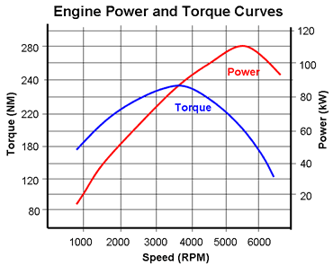

Bulldog Dyno
Will show data from pull. Unsure if updating during run or only after pull is finished
RPM:
6500
Torque:
190
kW
Constantly updating.
Power:
85
NM
Options
Save to CSV:
Filename
OR
Autogenerate
Start Log
End Log
Only one active at time. Other is greyed out. Will overwrite.
temp.csv
Will probably be in format “dyno_pull_MM_DD_YY:HH:MM.csv”

Slide 2
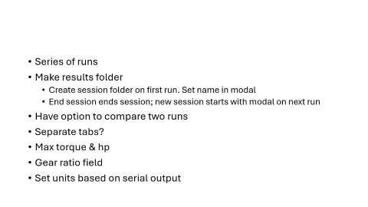
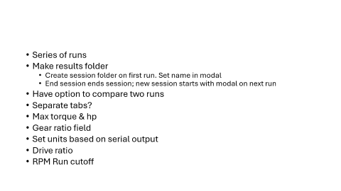
Series of runs
Make results folder
Create session folder on first run. Set name in modal
End session ends session; new session starts with modal on next run
Have option to compare two runs
Separate tabs?
Max torque & hp
Gear ratio field
Set units based on serial output
Drive ratio
RPM Run cutoff

